Slide 1
Microsoft Paint Tutorial
“Features of the program”

Slide 2
For those of you who don’t know…
This is Microsoft Paint

Slide 3
Important Features:
Pencil
Paintbrush
Colors
Select (move, copy/paste, cut)
Fill
Erase
Shapes
Insert text

Slide 4
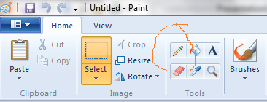
Pencil
This feature is one of the main drawing tools.
You can find it in the top left hand corner of the screen.
You can draw on anything. It is a very fine line.

Slide 5
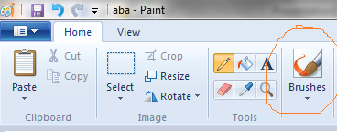
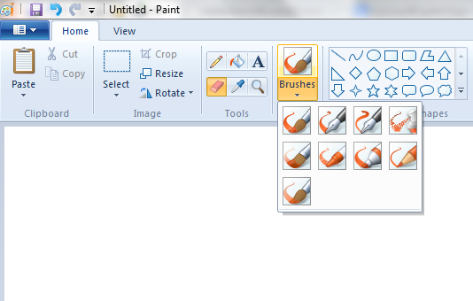
Paintbrush
This feature is also a main drawing tool. It’s a bit to the right of the pencil.
If you click the down arrow, you will see choices of different choices of thicker lines. Feel free to explore these options and find the right one for your project.

Slide 6
Colors
There are a bunch of great colors to choose from! On top of the ones they offer, you can also create your own variation of colors! Just click the Edit colors button.

Slide 7
Select
Now on to the harder stuff!
In the top left section of the tool bar, you’ll see a dotted square with “Select” underneath it. This feature allows you to choose a certain point of your painting and either move it, copy it, or delete it.

Slide 8
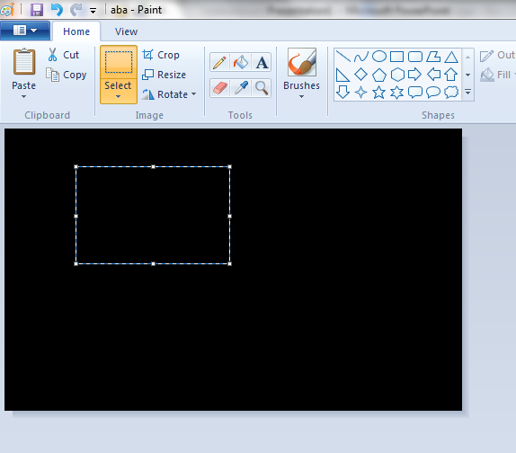
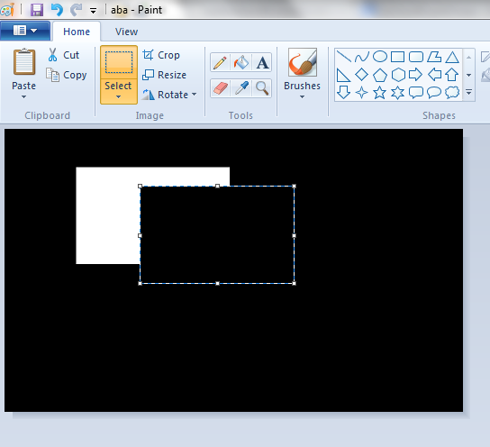
Select (move)
To move your selection, just click on it and while holding, move the cursor around. To place it, just let go of the mouse.

Slide 9
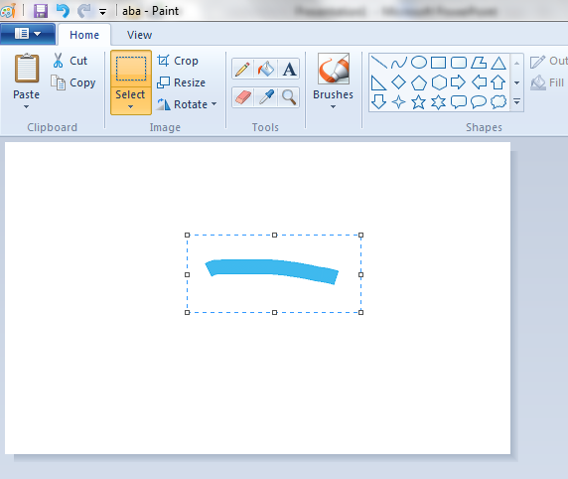
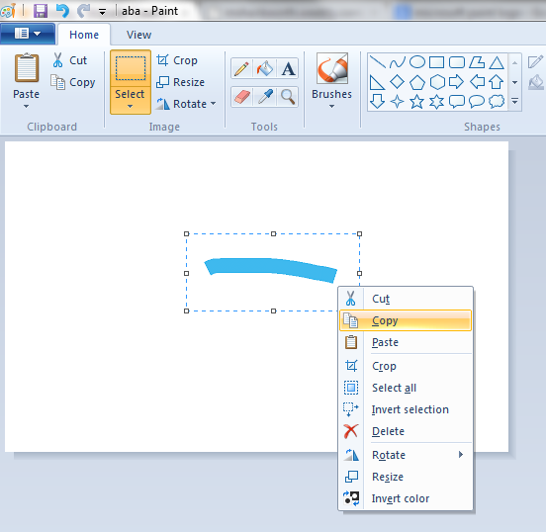
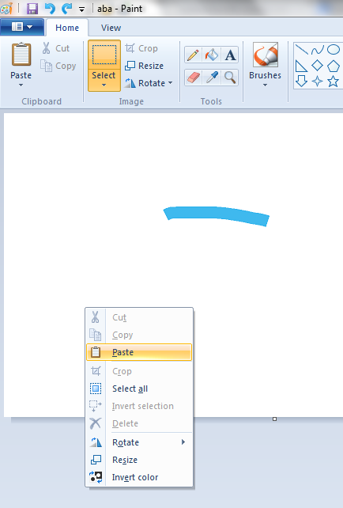
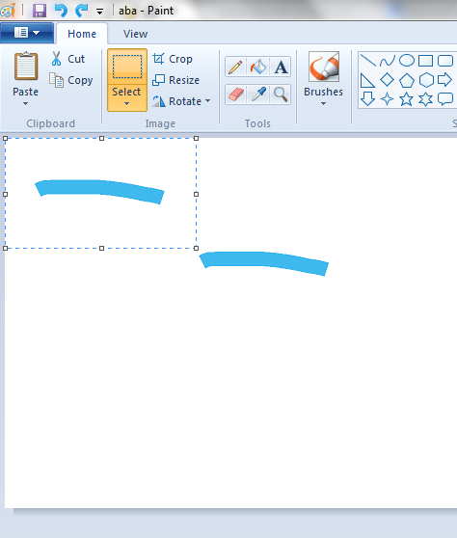
Select (copy)
To copy, select your piece, then right click and press copy.
Then move to a new spot and right click and press paste. Your copied shape appears in the top left corner.

Slide 10
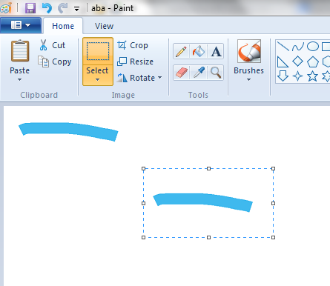
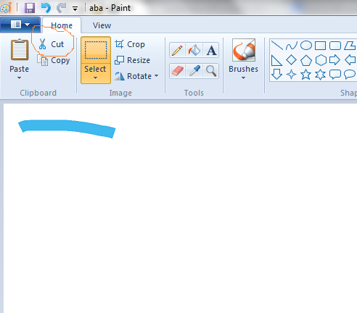
Select (delete)
To delete, select your piece, then up in the top left corner, hit cut. This deletes your selection.

Slide 11
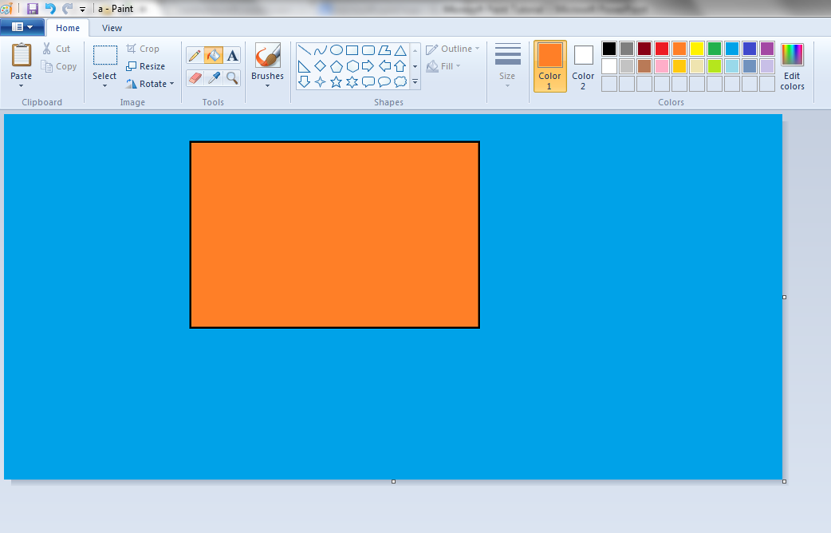
Fill
Let’s say now you’re trying to draw a watery undersea picture. Instead of using pencil to tediously color in the whole page, you can use the fill function to make the whole page blue- or whatever color you desire.

Slide 12
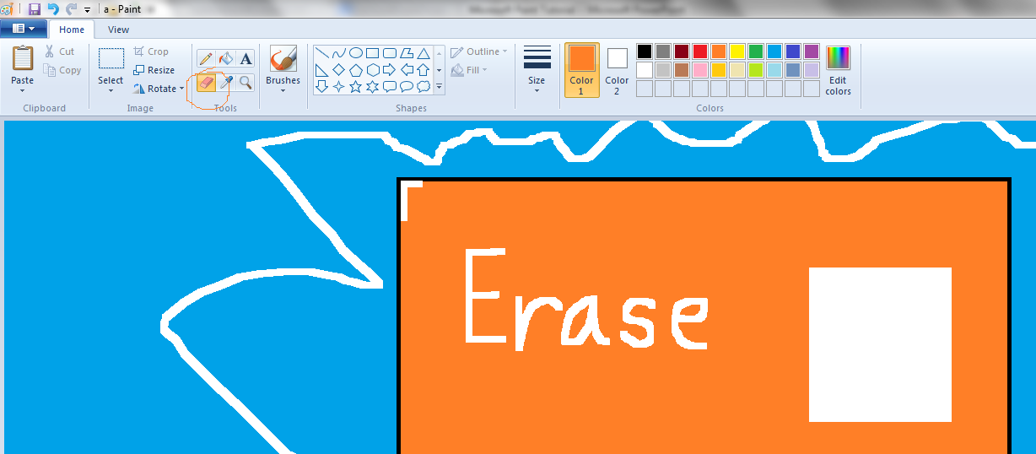
Erase
Everybody makes mistakes! The eraser is for more precise corrections. You can get into tight corners without ruining everything. The Select (delete) function is for mass erasing.

Slide 13
Shapes
Instead of spending minutes trying to freehand a perfect circle or square, Paint has a variety of different shapes you can easily draw.
Just click the shape you want and click and hold on the paper.
Move the mouse out to the size you desire and let go to complete the drawing.

Slide 14
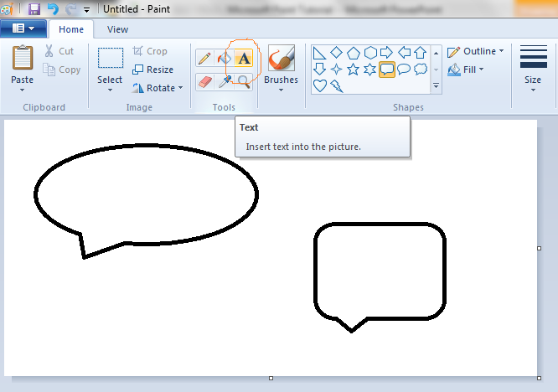
Insert Text
Along with shapes, colors, and lines, you can also add words to your pictures!
Click the “A” button in the top left corner of the tool bar and then click where you want to insert words.
Type in your text.
If you want to change the font, coloring, or size of the words, feel free to do so!

Slide 15
That’s all for now!
I’ve showed you the basics of Microsoft Paint.
This is just a small stepping stone leading to the many projects you can do in the future! Don’t forget to explore the colors, shapes, and designs this program has to offer!
Thanks for using my tutorial!

