Slide 1
Microsoft Excel Auto-Update Tutorial
Example: grocery list

Slide 2
Step 1: What do I need?
Before you do any auto-updating or inputting of values, you need to know what materials you need.
In this case what food we want to eat
Make a list and starting in the A1 box, type the names of the foods.
For each new item, go into a different box. Milk, A1, Crackers, A2, etc.

Slide 4
Step 2: How much does it cost?
Now that we know what we’re getting, we need to know how much it costs.
For each item, we’re going to input the price starting in C1.
Note: these prices aren’t necessarily real
We’re starting in C1 to give our item names room so the numbers aren’t crowded. You don’t have to start two columns over, I just prefer it.

Slide 6
Step 2.5: Uh oh! Format Cells
Right now you might be thinking, “Oh my gosh, why do my numbers look so weird? How do I get them to look like prices? What’s WRONG with this thing?”
DON’T worry! All we have to do is format the cells.
Right click on the C column box and find the Format Cells option. Click on it. (Figure 1)
Next, a screen should pop up and give you “choices of category”. (Figure 2)
Choose the “currency option”.
Fix your decimal places to the number you desire.
In this case, we’ll use two

Slide 7
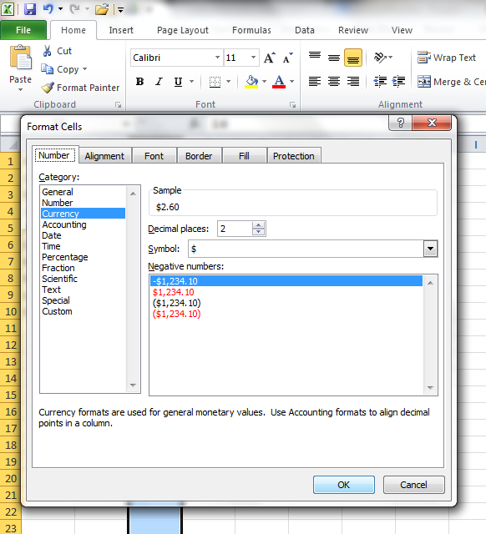
Figure 1
Figure 2

Slide 8
Step 3: How much do I want?
Now that we have the items and prices, we need to figure out how much of each thing we want.
Do I want 2 cartons of milk? How many bags of chips?
Input these values starting in the D1 column.
If you only need one of the item, there’s no need to put a 1 in the quantity column.

Slide 10
Step 4: Auto-Product! Woo-hoo!
Now that we have all of our values, we need to calculate them. Instead of getting a calculator out and adding/multiplying all of these numbers out, Excel was nice enough to put in a feature that does that for you- all you have to do is tell it what to do.
Double click on the E1 box.
Inside that, put an equals sign (=) and the columns you want to multiply (C1*D1) (Figure 3)
Use and asterisk as the multiplication symbol
Hit enter and your product shows up (Figure 4)

Slide 11
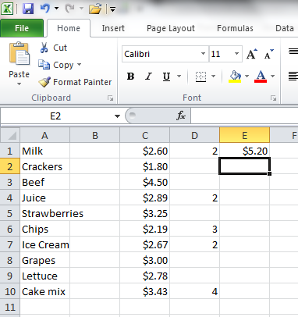
Figure 3
Figure 4

Slide 12
Step 4.5: What about the others?
Now we have one row set up, but there’s still other rows that aren’t auto-updated!
Right click on the E1 square and press “copy”.
Go to the next row where you have to multiply and right click on the box in the E column that corresponds.
Press “paste formula”.
The product for that specific row shows up in the box
Repeat these steps for each row that you need to multiply. (Figure 5)

Slide 13
Step 4.5 (continued)
We can’t forget about the numbers that don’t need to be multiplied! Those are important too.
We can still make a formula for them.
For the first non-multiplied number, in column E, double click and type in (=) and the location of the number you want to copy (in this case, C2). (Figure 6)
Then hit enter.
Copy and paste the formula as stated earlier in Step 4.5, as needed. (Figure 7)
(To make the numbers look like prices, see Step 2.5 – Figure 8)

Slide 14
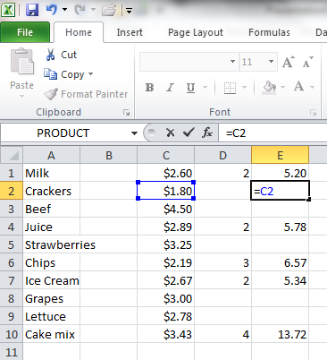
Figure 5
As you can see, the new formula (in the fx box) is C4*D4, so our original formula (C1*D1) copied correctly!
Figure 6

Slide 15
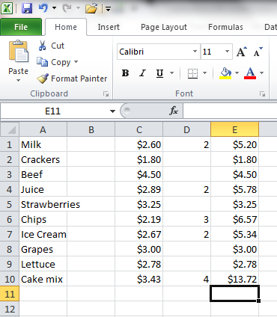
Figure 7
Figure 8

Slide 16
Step 5: Auto-Sum! Finally!
Let’s see, we have pretty much everything we need now- except for one thing. The total cost!
Highlight the last column we just updated. These are our subtotals. (Figure 9)
In the top right corner of the screen, there is an “Auto-Sum” button. Click this. (Figure 10)
Your total cost pops up under your column! (Figure 11)

Slide 17
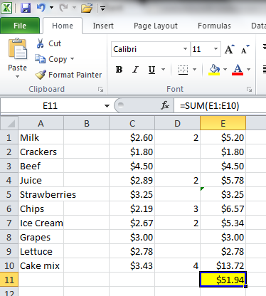
Figure 10
Figure 9
Figure 11

Slide 18
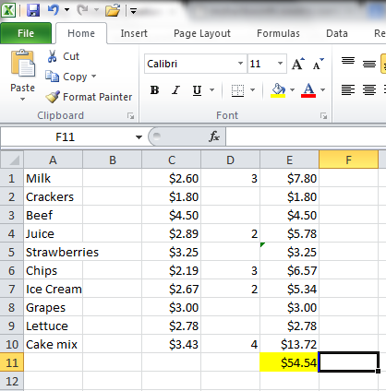
Let’s see if this works!
To test our auto-update function, let’s say I want 3 cartons of milk instead of 2. Let’s change that on our page.
Whoa! The total cost changes! Compare it to Figure 11.
Our formulas work! Great job!

Slide 19
We’re Done!!
This is definitely one high-tech grocery list, but thanks to Microsoft Excel, it’s also very organized.
Keep in mind that you can use this function for just about anything you need calculated or budgeted. This is also just one important feature on Microsoft Excel, there are many more that I didn’t get a chance to go over, so explore!
Thanks for using my tutorial!

