Slide 1
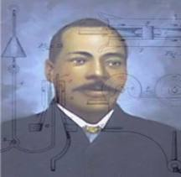
Railway Telegraphy System
Rannisha Mills: Advertiser
Sabrena Jackson: Researcher, Designer
Shawn Moore: Researcher
Diamond Garrett: Project Manager, Researcher, Designer Engineer

Slide 2
Who is Granville T. Woods?
Granville T. Woods was an inventor who dedicated his life to developing a large amount of inventions all involving the railroad industry.
He was also known as the “Black Edison”.
He most known invention was a system for letting train drivers know how close another train is to them.

Slide 3
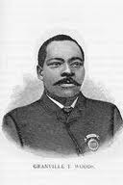
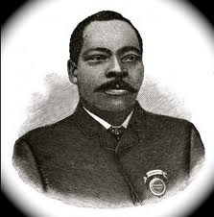
Granville T. Woods 1865-1910

Slide 4
What did Granville Woods Invent?
Granville T. Woods was a great electrician and an inventive genius.
Woods invented fifteen appliances for electric railways.
Just a few of his inventions:
Steam Boiler Furnace
Electric Railway
Automatic Air Brake
Telephone Transmitter
Electromechanical Brake
Railway Telegraph
Induction Telegraph System
Overhead Conducting System for Electrified Railway
Tunnel Construction for Electric Railway
Galvanic Battery

Slide 5
How does the Railway Telegraphy Work?
The original railway telegraphy system had the induction battery and the coils underneath the train car.
When electric currents (messages) were sent through the telegraph lines and came into proximity of the train car, the magnetic field resonating from the induction battery attracted the magnetic field from the telegraph lines, and the message transferred to the car.
These messages were the telegraph messages that people had to decode using Morse code—telegrams.
Granville T. Woods also wanted to introduce his “telegraphony” system to the railway communications scene.
He ran similar wires connected to coils around the induction battery and connected a telephone to the train car.
His invention reduced train crashes because they could now communicate with each other.
Though his system was largely effective and a blessing to train companies everywhere; we modern day inventors see small room for improvement.

Slide 6
Our Improvements!
Our new model has wires running underneath and above it. The wires underneath the car coil around an induction battery.
The wires are made of copper encased in rubber wire. They transmit well and are cheap enough for mass production.
The wires have a magnetic charge when they are connected to the battery.
On the top there is one wire connected to a transmitter that sends out the radar signal. It alerts other trains and the station where the train is.
The wires underneath go into the bottom of the train car and come up into the communications room.
In this room is the control desk. On the desk is a radar screen, telephone, on/off/reset button, emergency button, and locate button.
The locate button enables the worker to type in a train name using the keyboard and to find it on the radar screen.

Slide 7
Our Improvements Cont.
The magnetic wires under the car emit signals to the telephone lines that run parallel to the train tracks, enabling them to call other trains and the train station. Both the wires under the train and on the poles have a magnetic charge.
And when an electrical current is sent through them, the fields are attracted and the message transfers. The messages are sent on an alternating current and the power from the battery to the radar and the phone is a direct current.
Alternating currents are subject to changing directions and direct currents are just straightforward. From point A to point B.

Slide 8
