Slide 1
Appalachia Estates
“It’s Paradise in the Valley!”

Slide 2
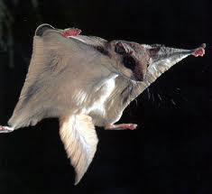
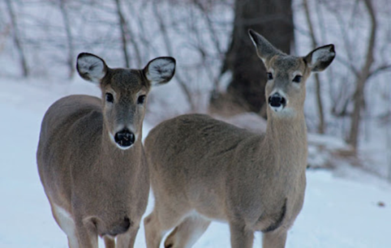
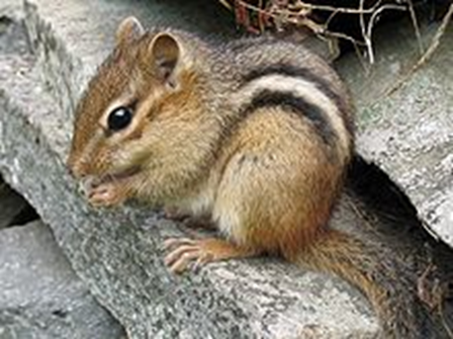
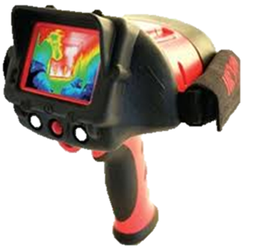
Animal Relocation Plan: We Care!
To ensure the safety of the native animals we plan to:
Send a professional surveyor team to scope the land and find the best building site.
Set up fencing around the chosen area to prevent invasion of the animals.
Within the perimeter, capture all the specified animals (whitetail deer, flying squirrels, chipmunks) in a humane manner and relocate them to another part of the forest.
Thoroughly re-inspect the building site to ensure all of the animals are safely removed.
Hire a team of wildlife experts to monitor the relocated animals to prevent overpopulation and make sure they adapt to the slightly new settings.
Flying Squirrel
Whitetail Deer
Eastern Chipmunk
Thermal heat detector

Slide 3
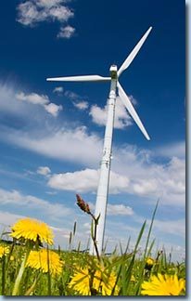
Eco-Friendliness of Our Community
To make the smallest carbon footprint we possibly can in a modernized world, we plan to:
Use Solar and Wind energy instead of gas/coal
Reutilization of the trees we cut down for construction or resale to future citizens
Limit the use of cars by strategically placing stores closer together
Construct our homes using eco-friendly materials i.e. non-VOC paint, energy efficient insulation, natural fiber carpeting
Have a recycling system in place
Thoroughly filter all sewage and reuse the water
Thoroughly sort all trash and reuse what we can
Encourage citizens’ purchase and installation of eco-friendly appliances i.e. absorption refrigerators, energy efficient washers, dryers, and dishwashers, CFL or LED light bulbs

Slide 4
Appalachia Estates Community Layout

